Slide 1

Fradel and Spies
Home
Service
About Me
Contact
SmartGrow
Agtech Crop

Slide 2
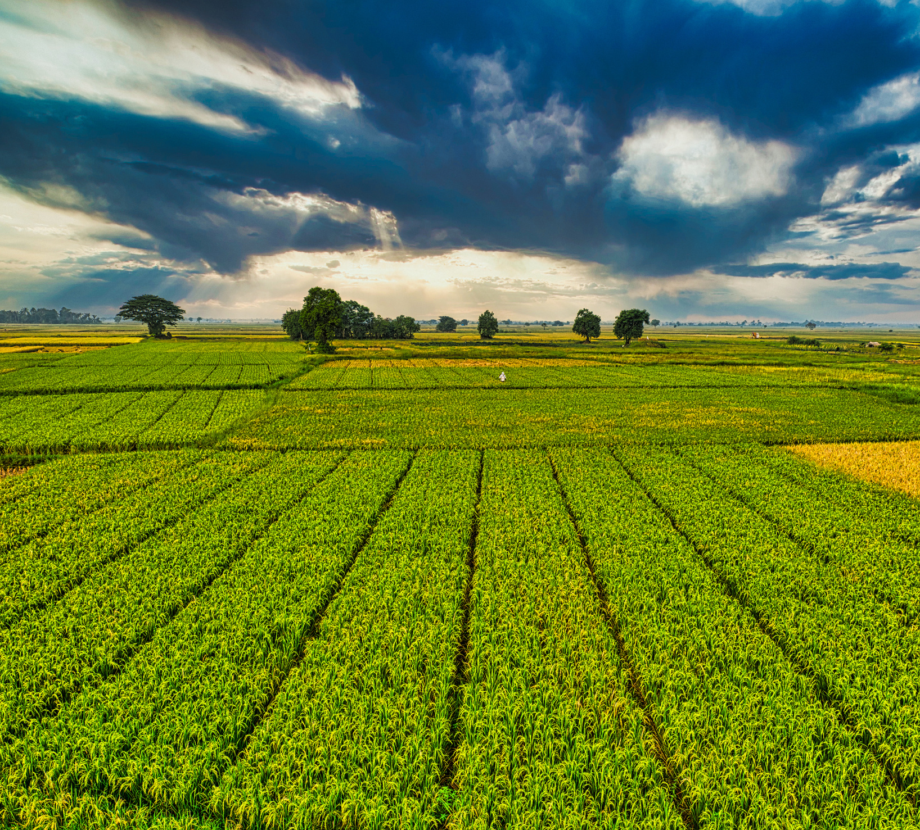
Fradel and Spies
Home
Service
About Me
Contact
About Our Agriculture
The agricultural technology (AgTech) industry is transforming traditional farming by integrating innovative technologies to improve efficiency, sustainability, and productivity. From precision farming using sensors and data analytics to advancements in soil management and crop monitoring, AgTech is revolutionizing the way we grow food. By leveraging AI, IoT, and machine learning, AgTech solutions enable farmers to optimize resource use, enhance crop yields, and reduce environmental impact. As the global population grows and environmental challenges intensify, AgTech is key to ensuring food security and fostering sustainable agricultural practices worldwide.

Slide 3
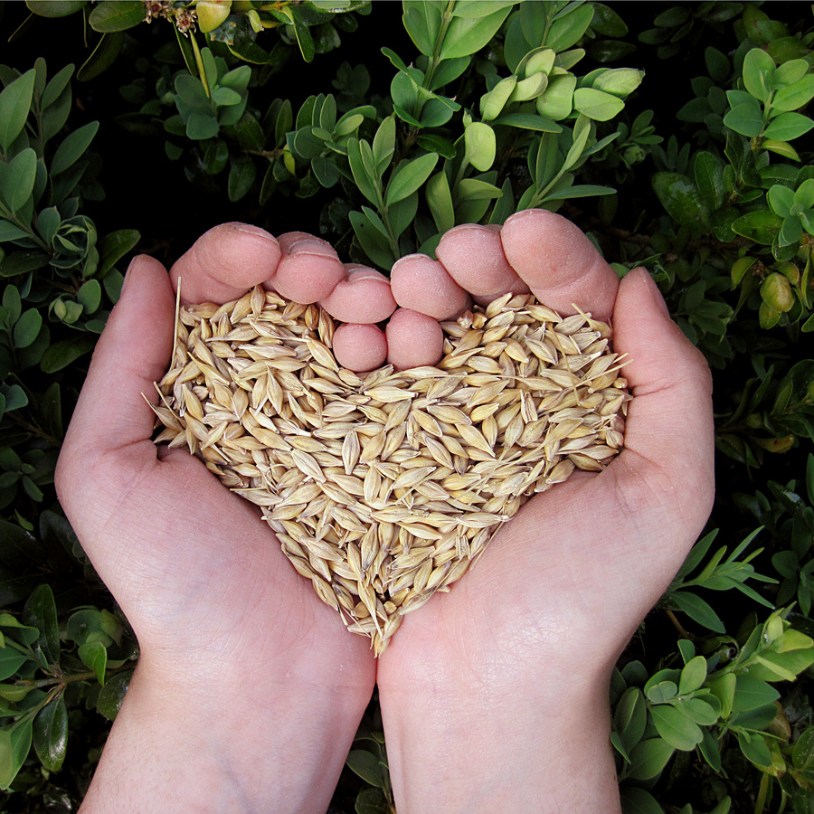
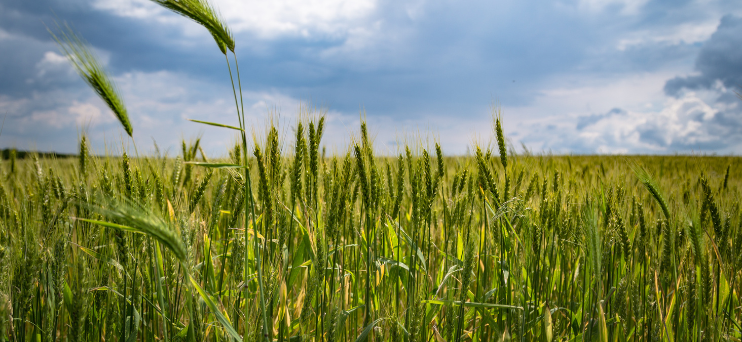
Fradel and Spies
Home
Service
About Me
Contact
What are the objectives?
"To identify the ideal crop variety for farmers based on environmental conditions to maximize yield and sustainability."
Why is predicting the ideal crop variety important for
farmers?
Predicting the ideal crop variety is essential for farmers because it helps maximize yield, minimize risks, and efficiently use resources. By choosing the right variety tailored to local soil, climate, and environmental conditions, farmers can increase productivity and reduce the likelihood of crop failure due to pests, diseases, or extreme weather. This approach also supports sustainable farming by optimizing inputs like water and fertilizers, making agriculture more resilient to climate change and ensuring better food security and profitability.

Slide 4
Fradel and Spies
Home
Service
About Me
Contact
How did you ensure the quality of your data?
We ensure data quality by sourcing from trusted origins, validating accuracy with automated checks, cleaning inconsistencies, and applying standardized formats. Additionally, we validated our data by cross-referencing with trusted agricultural guidelines and performing exploratory analysis to check for any inconsistencies. The dataset's integrity was continuously monitored throughout the feature engineering process.

Slide 5
Data Collection & Preprocessing
Initial Data Check
We began by reviewing 9 tables in the dataset.
The Plant table was the key table and used as the primary table for a left join with other tables.
Data Cleaning
Identified 190 missing values, which were replaced with 0 to ensure completeness.
For the Zone column, we clustered the values in ranges by combining inconsistent data from both the Plant and Hardiness tables to make it uniform.
Data Preprocessing
Cleaned and formatted data for consistency.

Slide 6
Exploratory Data Analysis (EDA)
Understand Data: Review structure, types, and distributions using summaries and visualizations.
Univariate Analysis: Analyze individual variables for patterns and distributions.
Bivariate/Multivariate Analysis: Explore relationships between variables using correlation, scatter plots, and heatmaps.
Hypothesize Insights: Identify trends, patterns, and anomalies to guide further analysis.

Slide 7
Input Variable : PlantName ,
SoilType,
UnifiedZone,
TemperatureStartRange,
TemperatureEndRange,
SoilTexture,
Classification(Humidity),
OrganicMatterContent,
SalinityLevel ,
Classification_Salinity
Output Variable : PlantType

Slide 8
PREDICTIVE MODEL

Slide 9
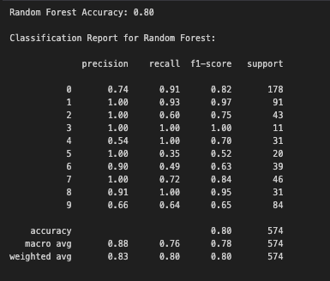
Random
Forest Model
Accuracy = 80%

Slide 10
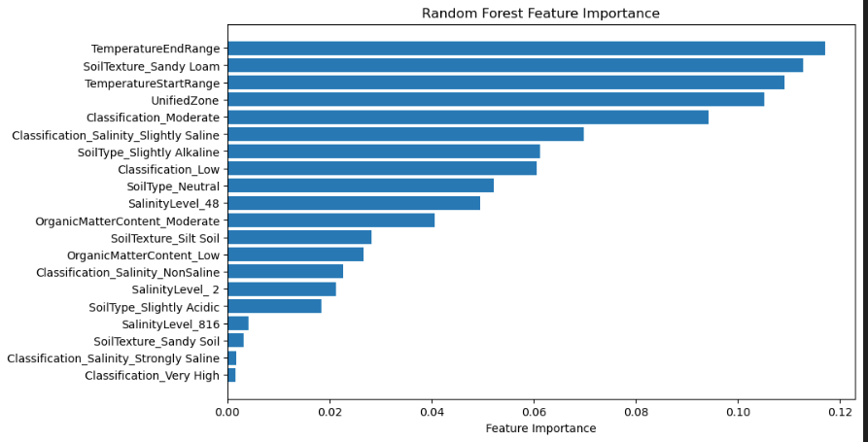

Slide 11
DATA VISUALIZATION

Slide 12
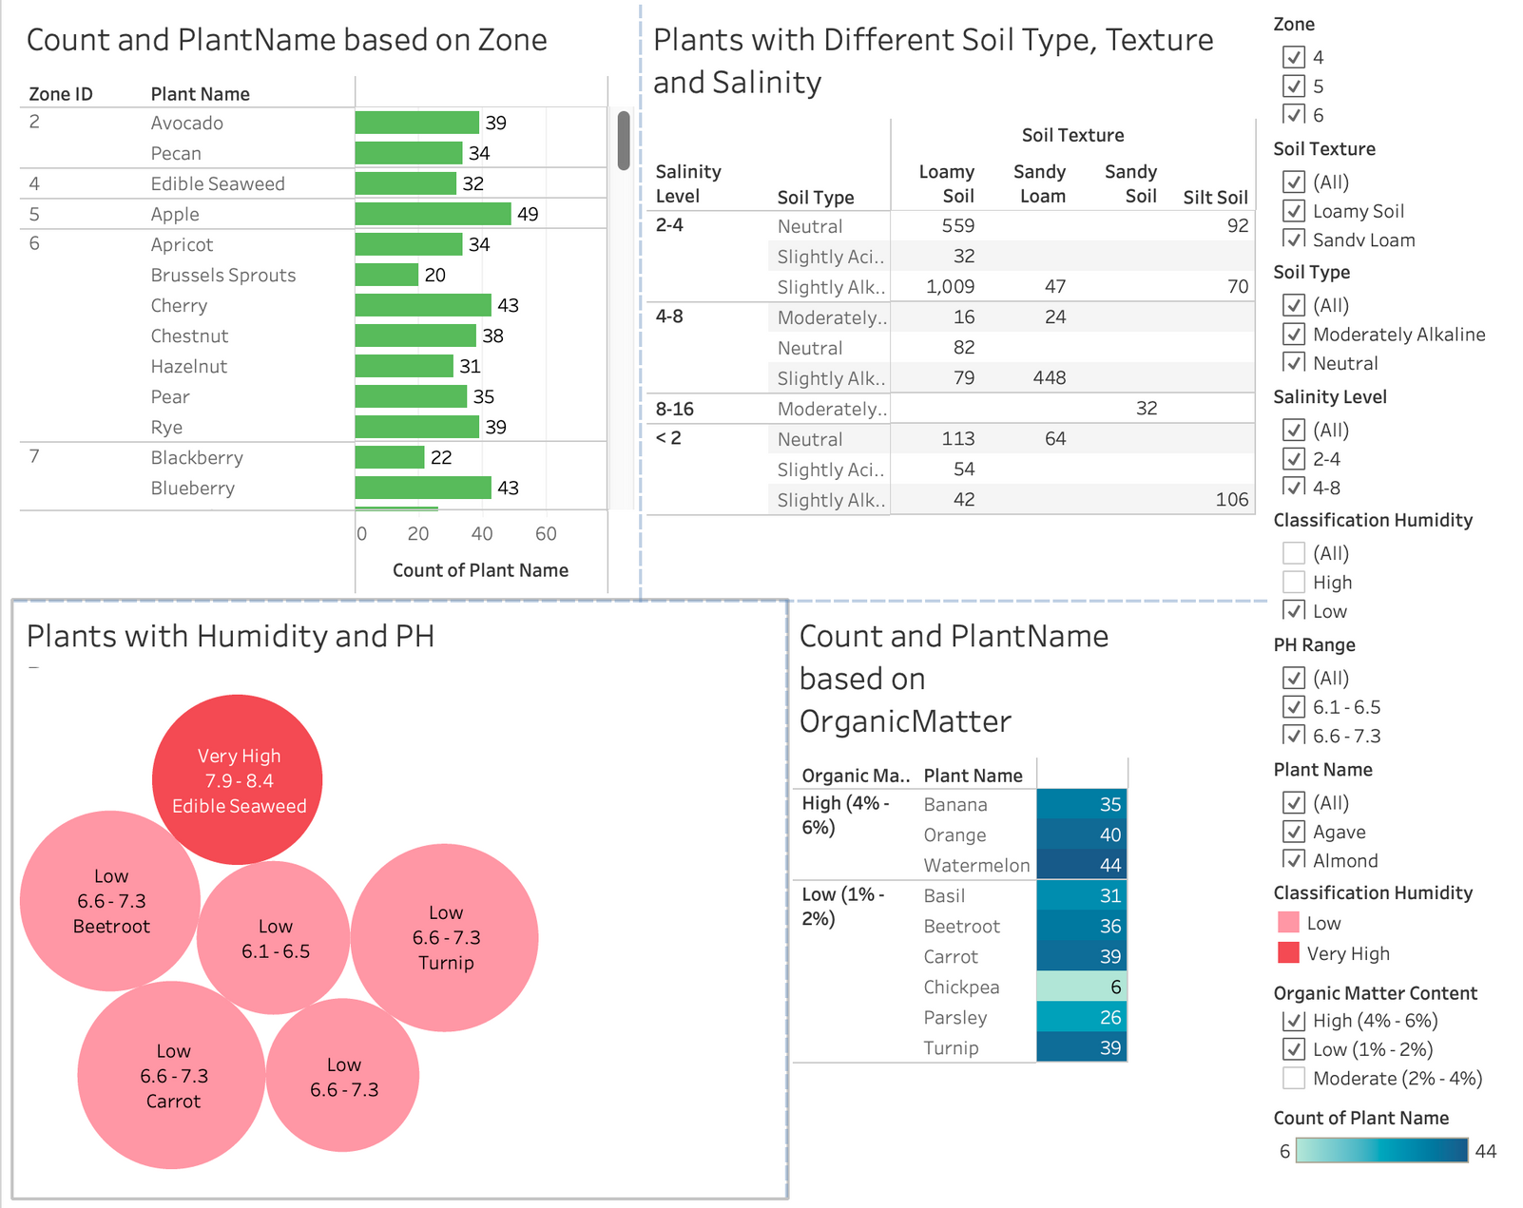
DASHBOARD

Slide 13
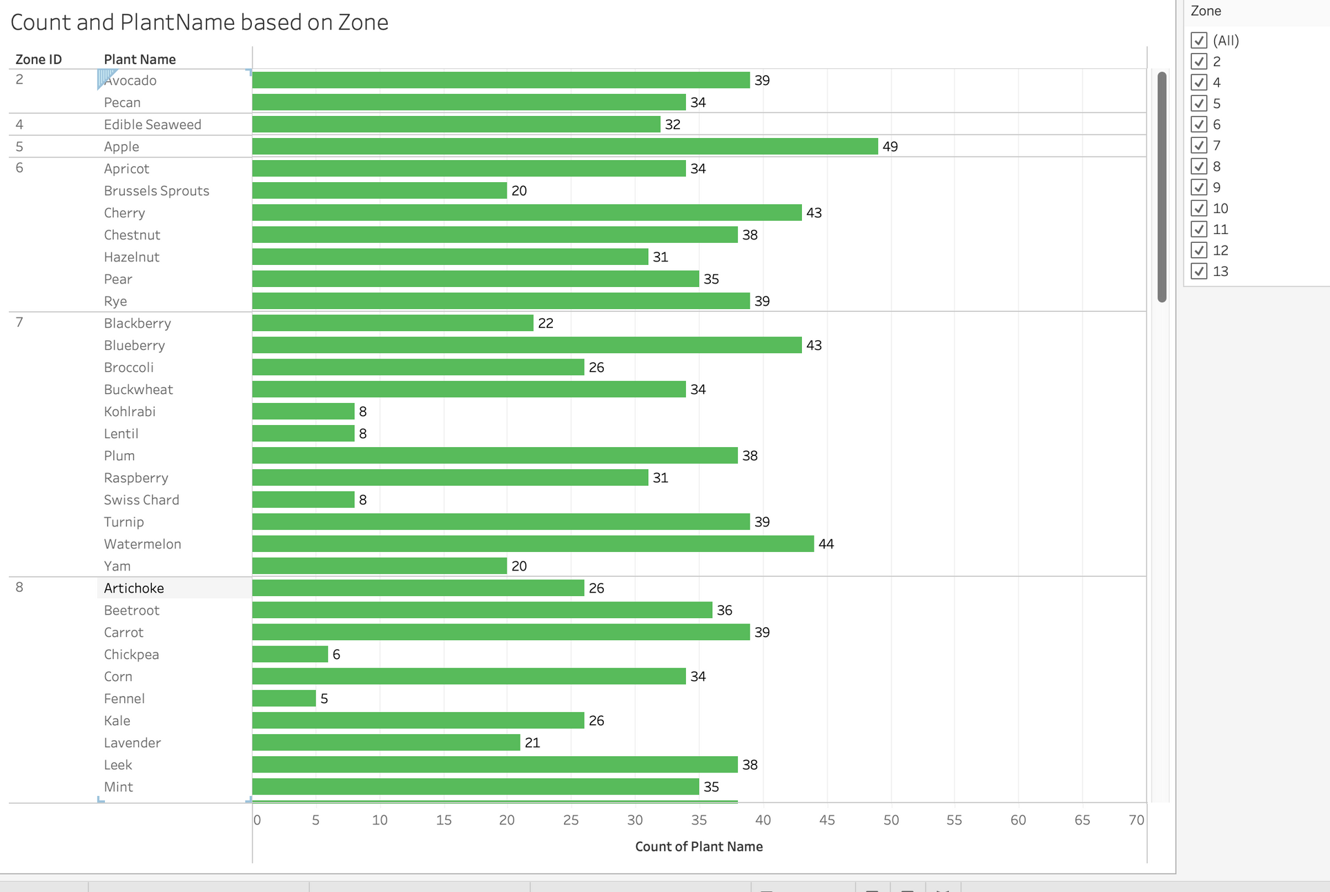
Which Plant is more prominent in which zone?

Slide 14
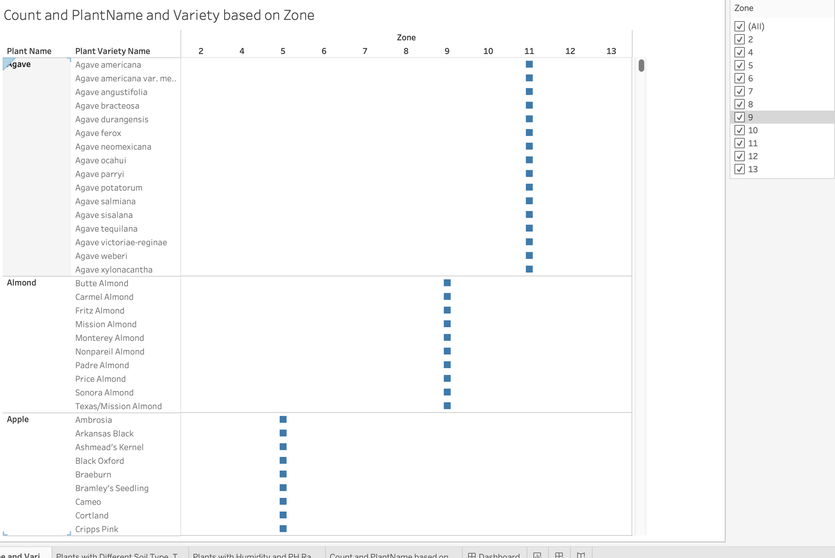
Which Plant Variety is more prominent in which zone?

Slide 15
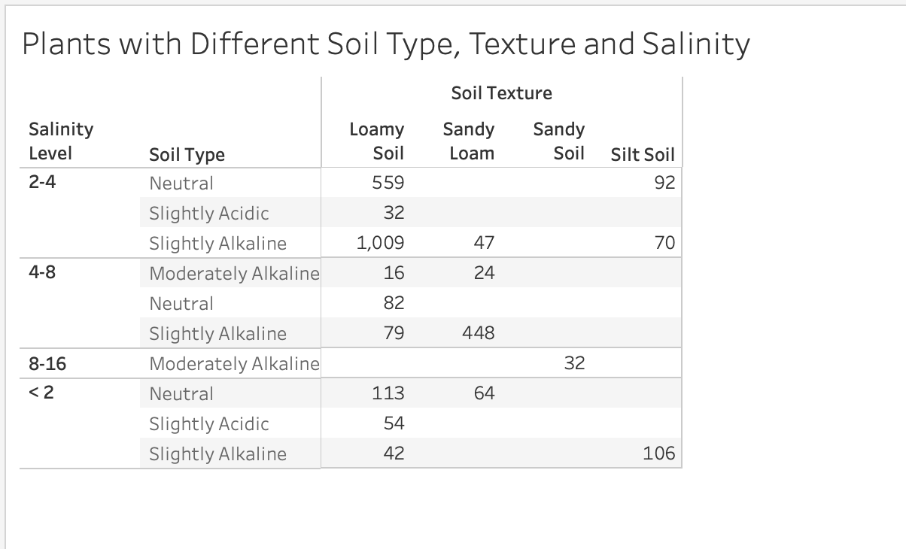
Which Soil Texture is considered based on Salinity and Type of Soil?

Slide 16
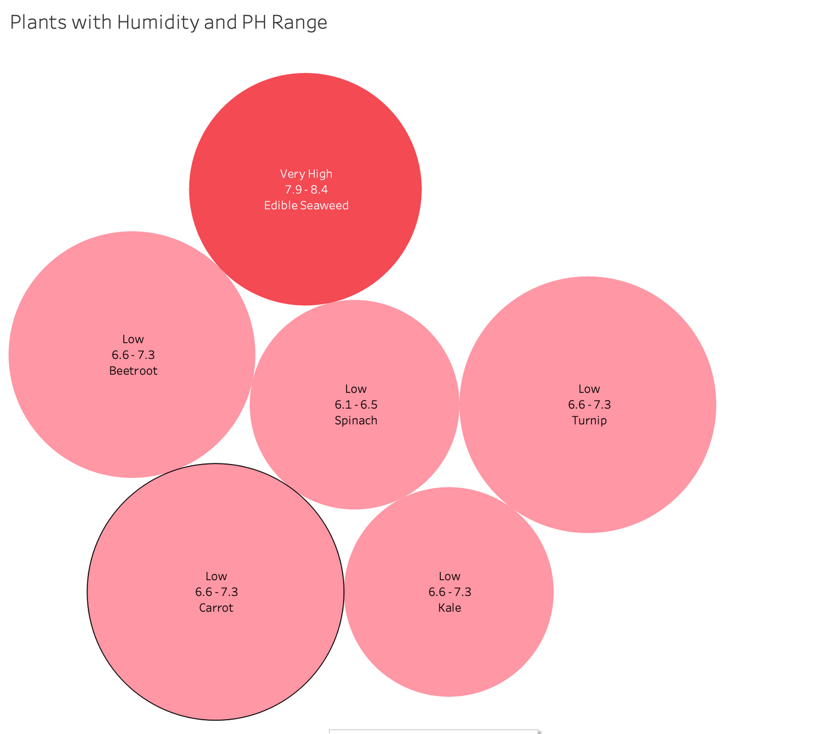
Plant at risk because of low and high humidityand PH level

Slide 17
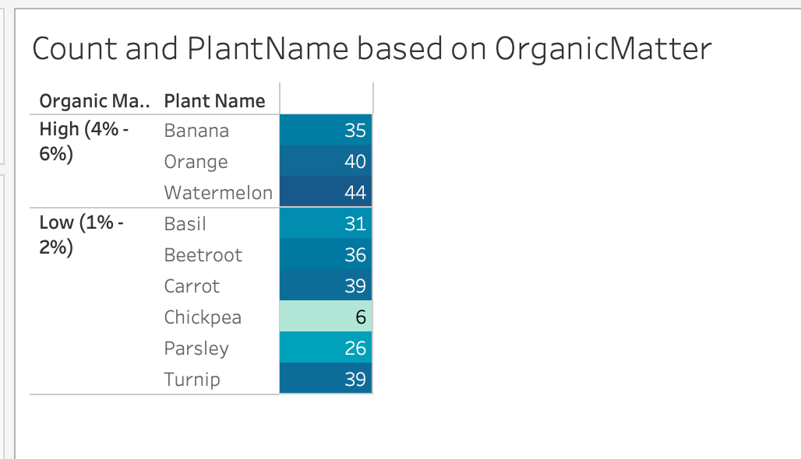
Plants prominent based on Organic Matter

Slide 18
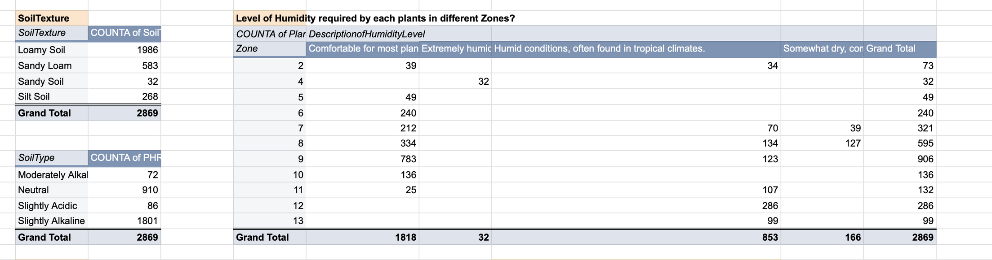

Slide 19
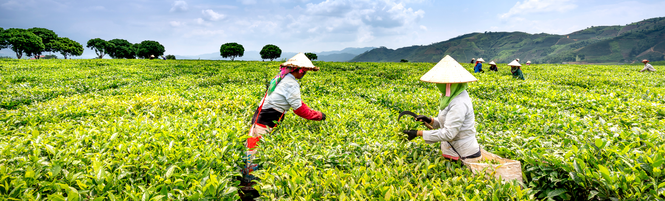
Fradel and Spies
Home
Service
About Me
Contact
Approach: Data analysis and machine learning to identify ideal crop varieties
Outcome: A user-friendly recommendation s
ystem tailored for farmers.
01
02
Solution
Q3
Process: Collect and analyze data, build predictive models,
and recommend the best crop variety.

Slide 20
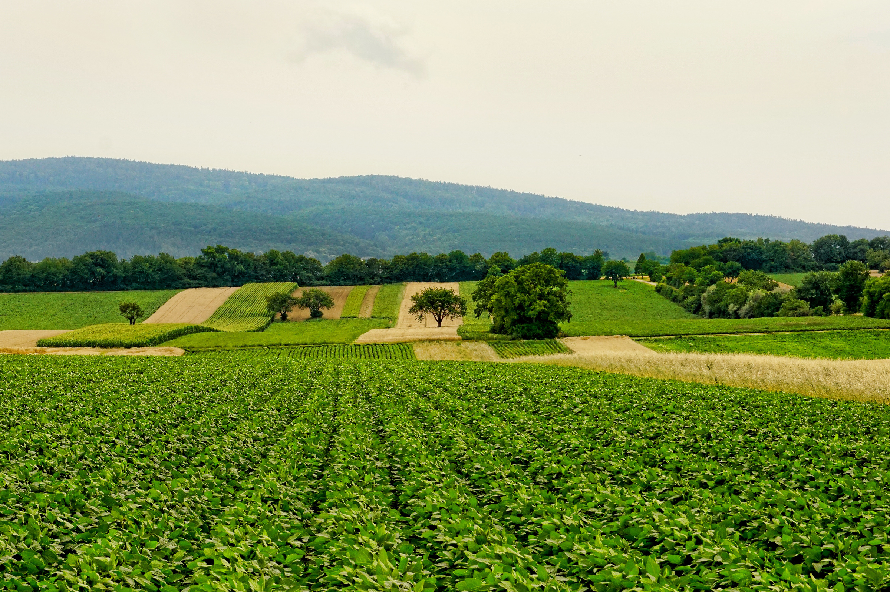
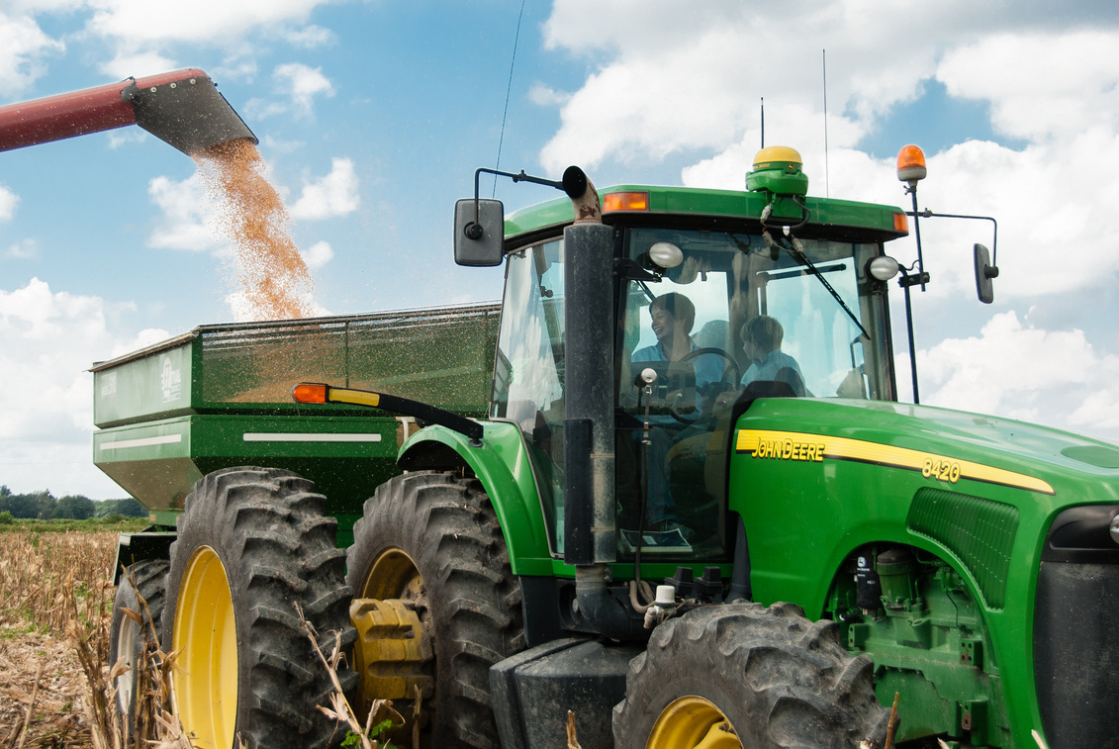
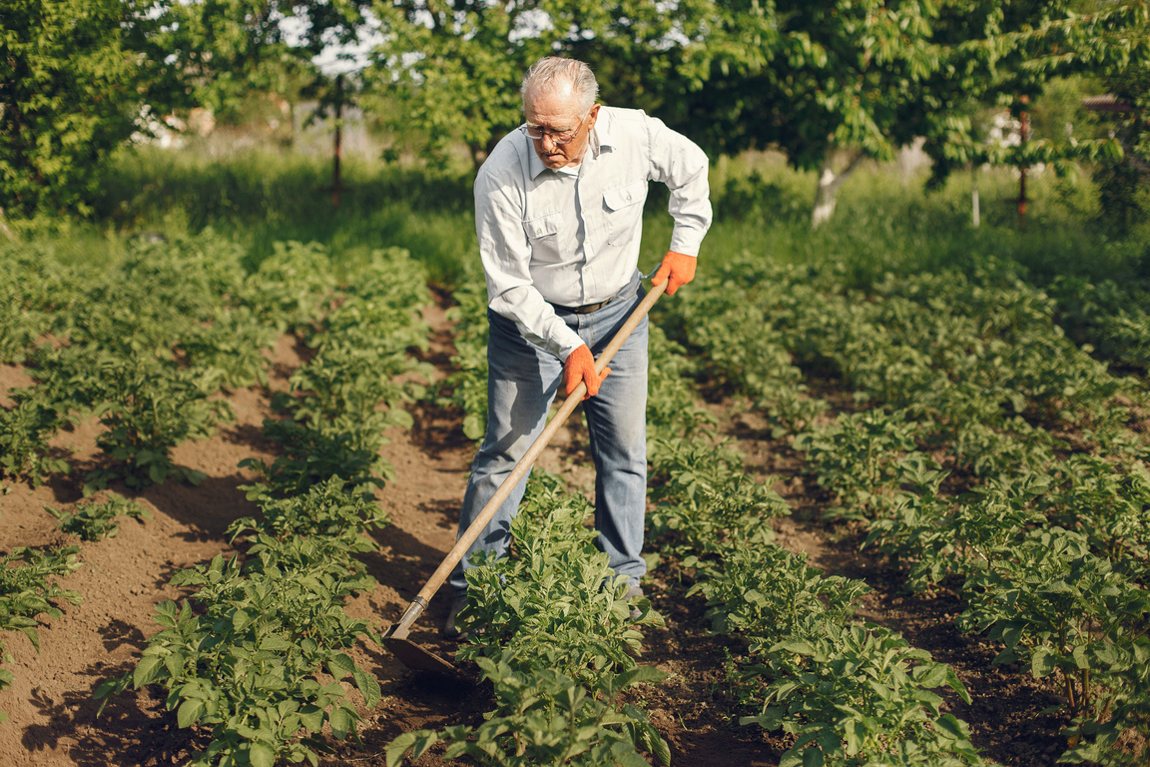

Fradel and Spies
Home
Service
About Me
Contact
OBSERVATIONS
Soil & pH: Match crops to soil texture and pH for optimal yields.
Climate Zones: Select crops suited to local climate for productivity.
Organic Matter: Maintain sufficient levels to boost soil fertility.
Salinity: Opt for salt-tolerant crops in high-salinity areas.
Weather Adaptation: Choose drought- or temperature-tolerant crops.
Crop Rotation: Improve soil health and reduce pests.
Pest Management: Use data to predict pests and limit pesticide use.
Water Efficiency: Align crops with local humidity and moisture.
Technology: Monitor and adapt practices with real-time tools.
Market Alignment: Grow crops with high demand and profitability.

Slide 21
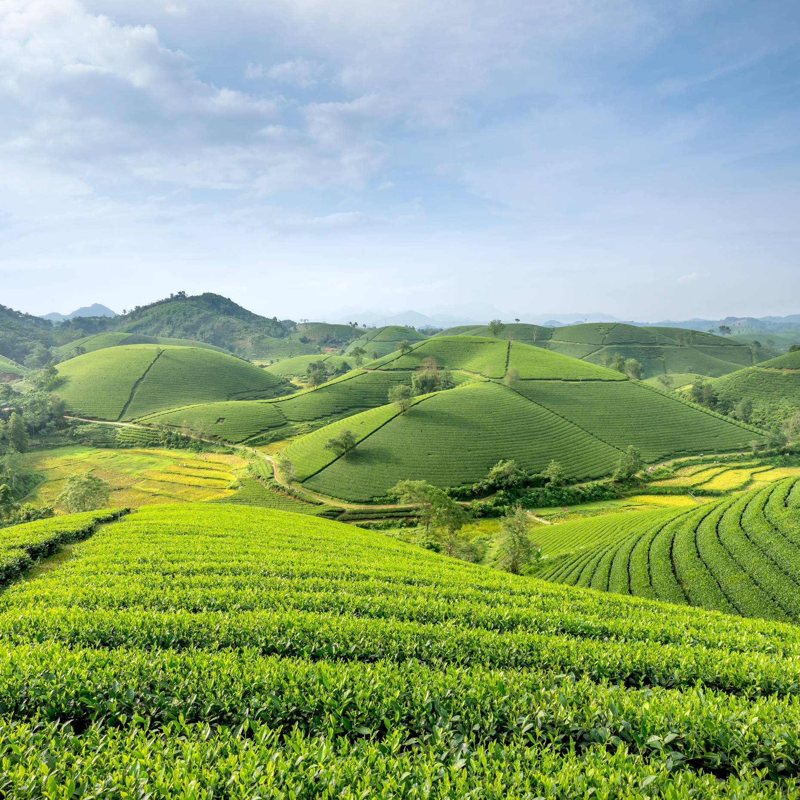
Fradel and Spies
Home
Service
About Me
Contact
RECOMMENDATION
Zone Recommendations:
Zone 5: Best for apple varieties due to favorable conditions.
Zone 6: Ideal for cherries and chestnuts, supported by diverse environmental factors.
Zone 7: Suitable for blackberries and blueberries, encouraging berry cultivation.
Soil Type Recommendations:
Slightly alkaline, sandy loam soils: Prioritize fruit crops like apples and pears.
Neutral loamy soils: Best for root crops like carrots and beets.
Organic Matter Content:
High organic matter (4%-6%): Suitable for bananas, oranges, and watermelons.
Low organic matter (1%-2%): Ideal for root vegetables like beetroot, carrot, and turnip.
Additional Considerations:
Low-humidity areas with pH 6.1–7.3: Best for crops like carrots and beets, promoting sustainable farming.

Slide 22
Fradel and Spies
Home
Service
About Me
Contact
THE NULL SET
The Null Set is a clever, nerdy team name that implies both mystery
and a strong grasp of fundamental mathematical concepts

Slide 23
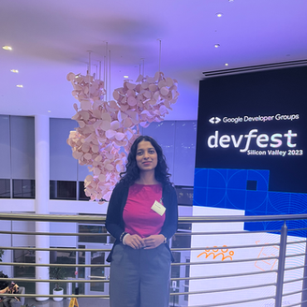
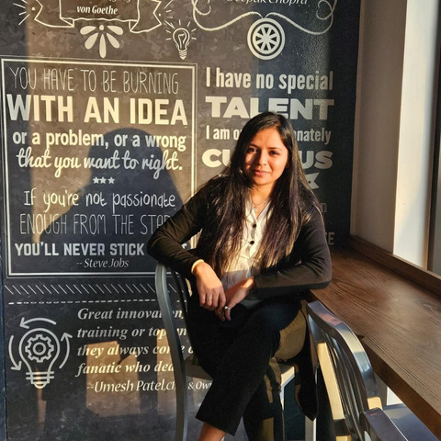

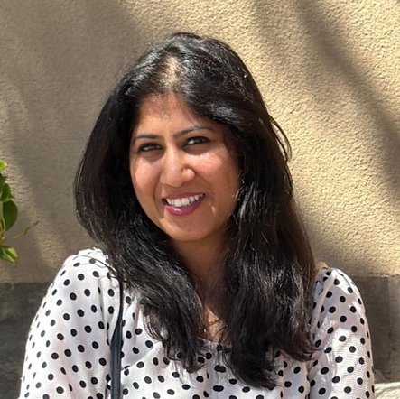
Fradel and Spies
Home
Service
About Me
Contact
Meet Our Team
Mahima Advilkar
Komal Nayak
Osheen Gupta
Vibha Gupta

Slide 24
Fradel and Spies
Home
Service
About Me
Contact
Thank You

